Slide 1
A large neighborhood search heuristic for the longest common subsequence problem
Todd Easton, Abhilash Singireddy
Journal of Heuristics 14(2008), pp. 271~283
Presenter : Hsiang-Yi Weng
Date : Nov. 4, 2008

Slide 2
Abstract
Given a set S={S¹, … , S^{k}} of finite strings, the
k-Longest Common Subsequence Problem (k-LCSP)
seeks a string L* of maximum length such that L* is a
subsequence of each S^{i} for i=1, …, k. This paper presents a
large neighborhood search technique that provides quality
solutions to large k-LCSP instances. This heuristic runs in
linear time in both the length of the sequences and the
number of sequences. Some computational results are
provided.

Slide 3

k-Longest Common Subsequence problem
(k-LCSP)
S₁=AGCTAATC
S₂=GTACGATC
S₃=TATCCATC
LCS=ACATC

Slide 4
Solving k-LCSP
Dynamic programming (DP), O(n^{k}).
Specialized Branching (SB), O(k|Σ|^{|L*|})
G and V
Long Run algorithm (LR), O(σ k n).
Expansion algorithm (EA), O(nm²logm)
Time horizon specialized branching heuristic
(THBS), O(nk|Σ|^{p})

Slide 5
Long Run algorithm (LR)
  s1 = GCCGAAGTGGCT (2A 5G 3C 2T)
  s2 = AGCTACAGTGCT (3A 3G 3C 3T)
  s3 = AGACATGTACGA (5A 3G 2C 2T)
  s4 = ACGCAAGTGAGC (4A 4G 3C 1T)
  min: (2A 3G 2C 1T)
  CS = *G
  s1 = GCCGAAGTG (2A 4G 2C 1T)
  s2 = AGCTACAGT (3A 2G 2C 2T)
  s3 = AGACATGTAC (4A 2G 2C 2T)
  s4 = ACGCAAGTGA (4A 3G 2C 1T)
  min: (2A 2G 2C 1T)
  CS = *GG

Slide 6
Long Run algorithm (LR)
  s1 = GCCGAAGT (2A 3G 2C 1T)
  s2 = AGCTACA (3A 1G 2C 1T)
  s3 = AGACAT (3A 1G 1C 1T)
  s4 = ACGCAAGT (3A 2G 2C 1T)
  min: (2A 1G 1C 1T)
  CS = *AGG
  s1 = GCCGA (1A 2G 2C 0T)
  s2 = AGCTAC (2A 1G 2C 1T)
  s3 = AGAC (2A 1G 1C 0T)
  s4 = ACGCA (2A 1G 2C 0T)
  min: (1A 1G 1C 0T)
  CS = GAGG

Slide 7
Expansion Algorithm (EA)
Σ={A, G, C, T}
S¹=AAGGCCACTTCATGGAAA
S²=ACCCCGTGTTGGATAA
S³=CCCCTTCTGGAAA
S⁴=ACTGCCGTTCTGGAA
S¹=A²G²C²ACT²CATG²A³
S²=AC⁴GTGT²G²ATA²
S³=C⁴T²CTG²A³
S⁴=ACTGC²GT²CTG²A²

Slide 8
Expansion Algorithm (EA)
S¹=A²G²C²ACT²CATG²A³
S²=AC⁴GTGT²G²ATA²
S³=C⁴T²CTG²A³
S⁴=ACTGC²GT²CTG²A²
Streams of length 2 are only GA, CA, CT, CG, TA and TG.
stream: CTGA
CTGA C²TCA C²T²GA C²T²G²A C²T²G²A²
C³T²G²A² C³T³G²A² CCCTTTGGAA

Slide 9
Time horizon specialized branching heuristic
(THBS)
(0,0,0)
AGCT
GTAC
TATC
G
A
T
C
S₁=AGCTAATC
S₂=GTACGATC
S₃=TATCCATC
P=4, Q=0.5
(1,3,2)
(4,2,1)
(3,4,4)
(2,1,φ)
A
T
C
G
(φ,1, φ)
(4, φ, 3)
(3,4, 4)
(3,4, 4)
(2, φ, φ)
L*=AC
The length of L* is 2.
2*0.5=1
Keep “A”
L=A

Slide 10
Time horizon specialized branching heuristic
(THBS)
(0,0,0)
GCTAAT
CGAT
TCCAT
G
A
T
C
S₁=AGCTAATC
S₂=GTACGATC
S₃=TATCCATC
P=4, Q=0.5
(4,3,4)
(3,4,1)
(2,1,2)
(1,2, φ)
A
T
C
G
(φ,2, φ)
(4,3,4)
(3,4,5)
(φ, φ,3)
A
T
C
G
L*=CAT
The length of L* is 3.
3*0.5=1.5
Keep “CA”
L=ACA
(φ, φ, φ)
(5, φ, φ)
(6,4,5)
(φ, φ, φ)

Slide 11
Time horizon specialized branching heuristic
(THBS)
(0,0,0)
ATC
TC
TC
G
A
T
C
S₁=AGCTAATC
S₂=GTACGATC
S₃=TATCCATC
P=4, Q=0.5
(1, φ, φ)
(2,1,1)
(3,2,2)
(φ, φ, φ)
A
T
C
G
(φ, φ, φ)
(φ, φ, φ)
(φ, φ, φ)
(3,2,2)
L*=TC
The length of L* is 2.
2*0.5=1
Keep “T”
L=ACAT

Slide 12
Time horizon specialized branching heuristic
(THBS)
(0,0,0)
C
C
C
G
A
T
C
S₁=AGCTAATC
S₂=GTACGATC
S₃=TATCCATC
P=4, Q=0.5
(φ, φ, φ)
(φ, φ, φ)
(1,1,1)
(φ, φ, φ)
L*=C
The length of L* is 1.
2*0.5= 0.5
Keep “C”
L=ACATC
The reported common subsequence is ACATC

Slide 13
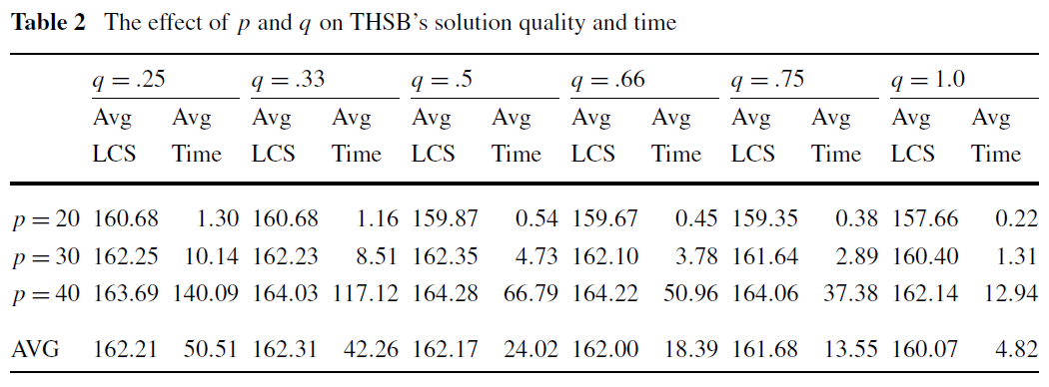
Computational results

Slide 14
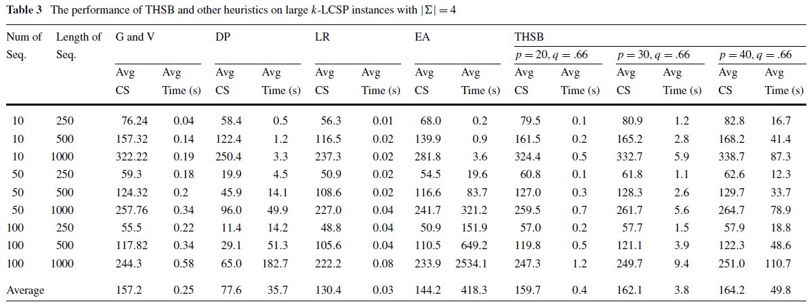
Computational results

Slide 15
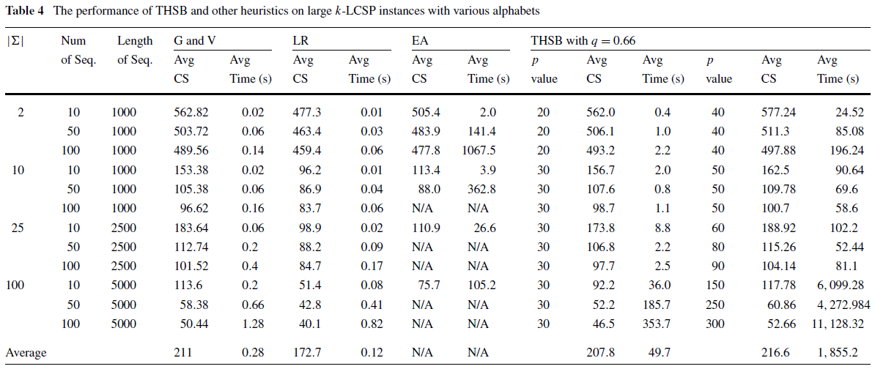
Computational results

